Slide 1
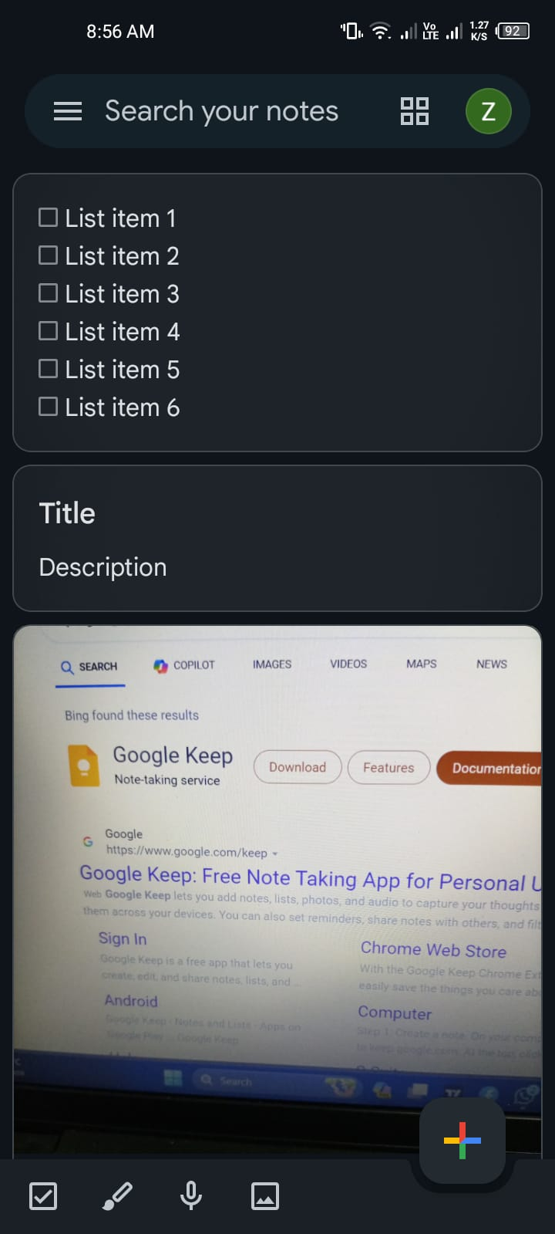
Well-Designed Product: Google Keep

Slide 2
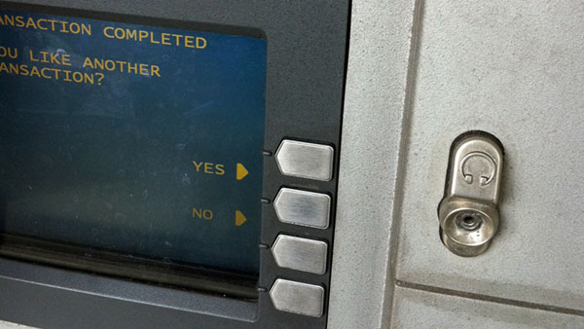
Poorly-Designed Product: Automated Teller Machine (ATM)

Slide 3
Easy-to-use
Q1. What is the product?
Google Keep is a note-taking application that allows users to create, organize, and share notes, lists, and reminders.
Q2. What task does the product perform?
Google Keep helps users capture and organize information quickly and efficiently. It supports text notes, voice notes, checklists, and photo notes.
Q3. Present one way in which this product is easy for you to use:
Google Keep has an intuitive, minimalist interface with clear icons and simple navigation. Adding a new note is straightforward, and the drag-and-drop functionality for rearranging notes is very user-friendly.
Q4. How would someone else find this product difficult to use?
Someone who is not familiar with digital note-taking tools or who prefers more structured note organization might find Google Keep's freeform approach to be chaotic and disorganized.
Q5. How could this difficulty be resolved?
To assist users who prefer more structure, Google Keep could offer templates or customizable note formats that guide users in creating and organizing their notes more systematically.

Slide 4
Difficult-to-use
Q1. What is the product?
This product is an Automated Teller Machine (ATM) from a local bank.
Q2. What task does the product perform?
The ATM allows users to perform banking transactions such as withdrawing cash, checking account balances, and transferring money between accounts.
Q3. Present one way in which this product is difficult for you to use:
The ATM's interface is cluttered and confusing, with a mixture of touch screen and physical buttons. The prompts are not clear, and the flow of actions is not intuitive, often leading to user errors.
Q4. How could this difficulty be resolved?
The ATM interface could be redesigned to have a more streamlined, step-by-step process with clearer instructions and fewer options presented at once. Consistent use of either touch screen or physical buttons would also improve usability.
Q5. How would someone else find this product easy to use?
Someone who frequently uses this specific ATM and is familiar with its quirks and layout might find it easy to navigate due to their repeated exposure and learned experience.

Slide 5
Summary of Important Difference
The key difference between Google Keep and the local bank's ATM lies in the design
and user interface clarity. Google Keep’s minimalist and intuitive design caters to
both novice and experienced users by providing a straightforward, easy-to-navigate
interface. In contrast, the local bank’s ATM has a cluttered and inconsistent interface
that confuses new users and relies on familiarity rather than intuitive design,
highlighting the importance of clear and user-centered design principles.

